Slide 1


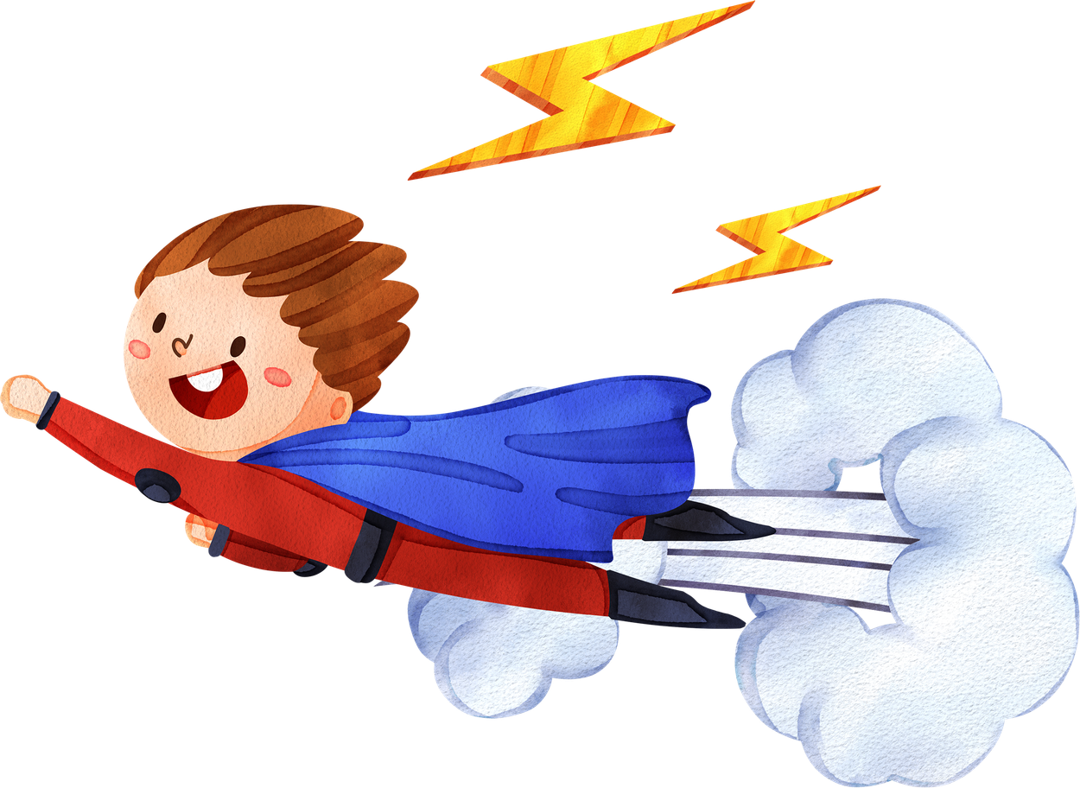


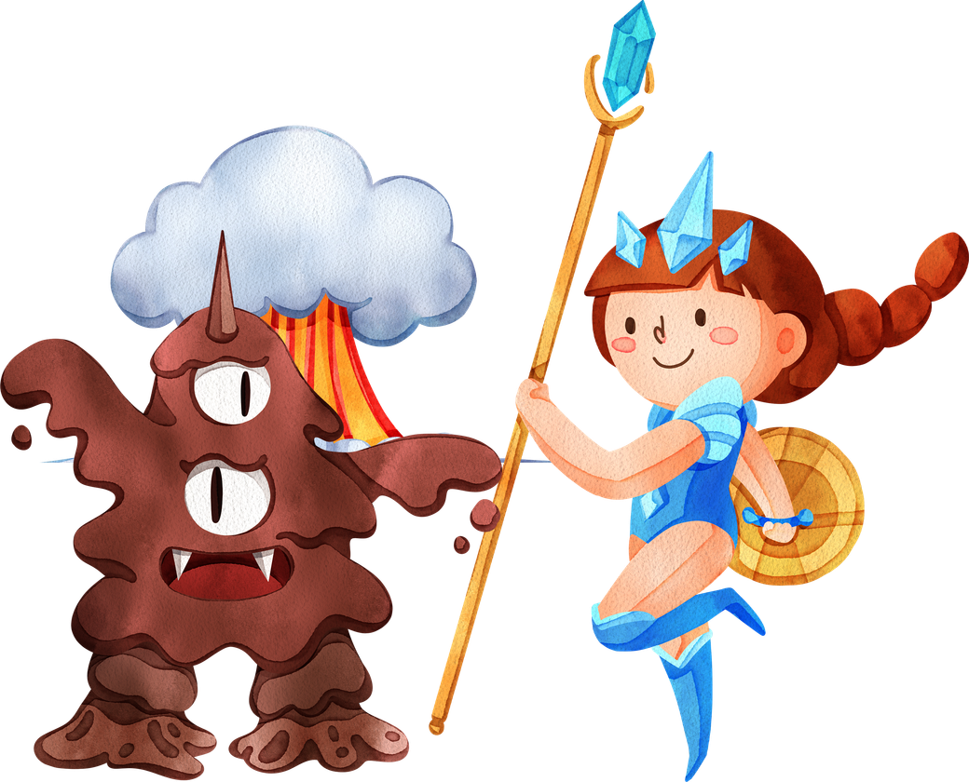


CALLED TO BE
End Game
A HERO!
WE CAN‘T SAVE OURSELVES

Slide 2

CALLED TO BE
A HERO!

Slide 3
CALLED TO BE
A HERO!
big

Slide 4
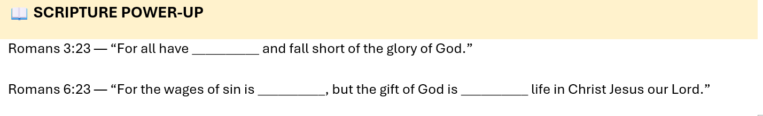
CALLED TO BE
A HERO!

Slide 5
CALLED TO BE
A HERO!
sinned
death
Eternal

Slide 6
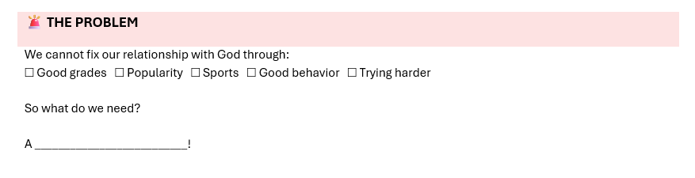
CALLED TO BE
A HERO!

Slide 7
CALLED TO BE
A HERO!
Savior

Slide 8
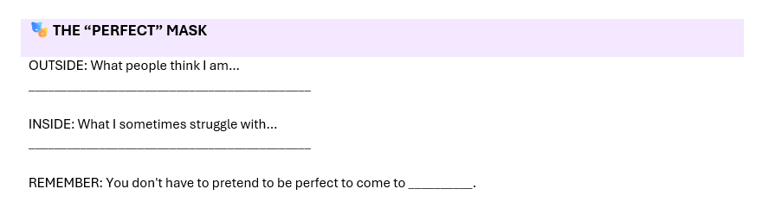
CALLED TO BE
A HERO!

Slide 9
CALLED TO BE
A HERO!
Jesus

Slide 10
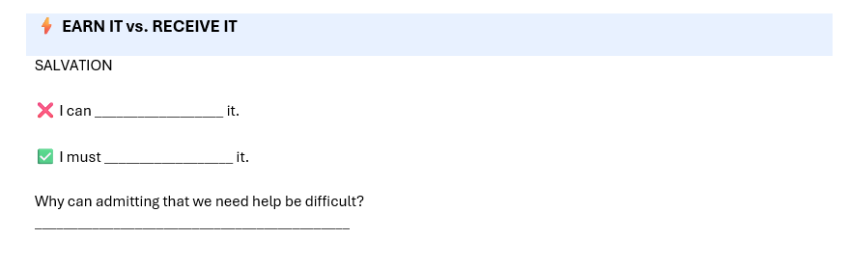
CALLED TO BE
A HERO!
earn
Recieve

Slide 11
CALLED TO BE
A HERO!
Do
Surrender
Sometimes admitting we need help is difficult because of pride. It’s hard to ask for help because it may seem we are weak.

Slide 12
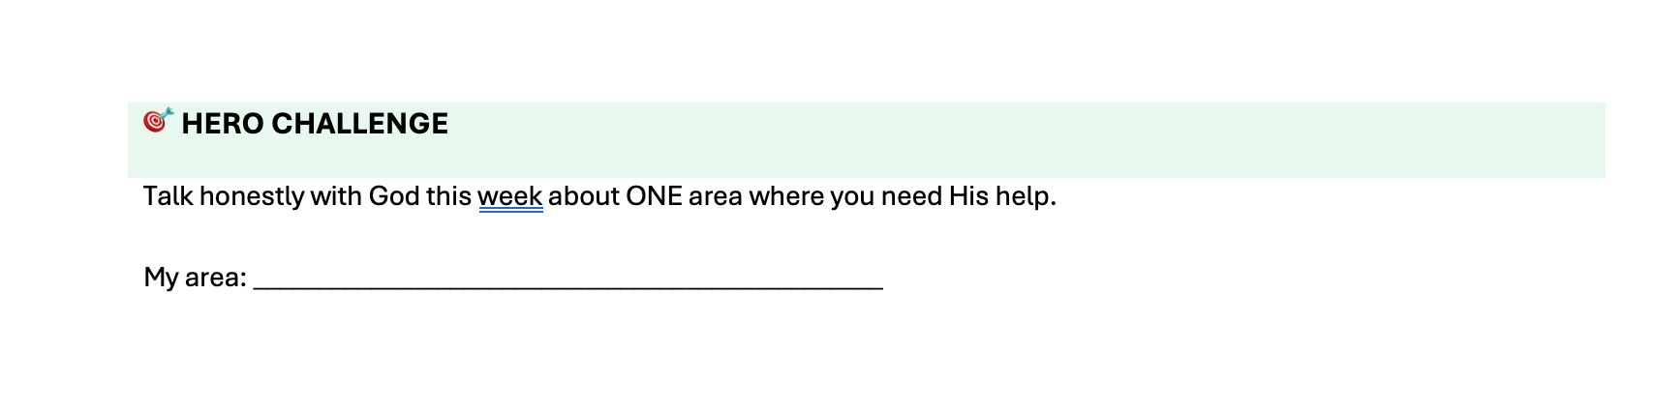
CALLED TO BE
A HERO!

