Slide 1


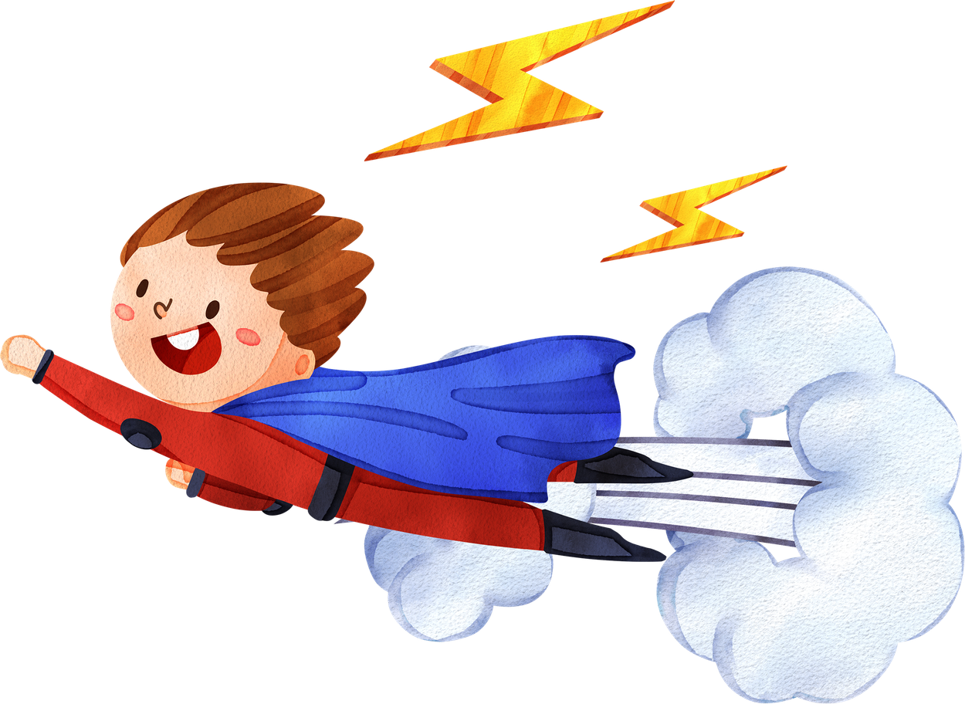

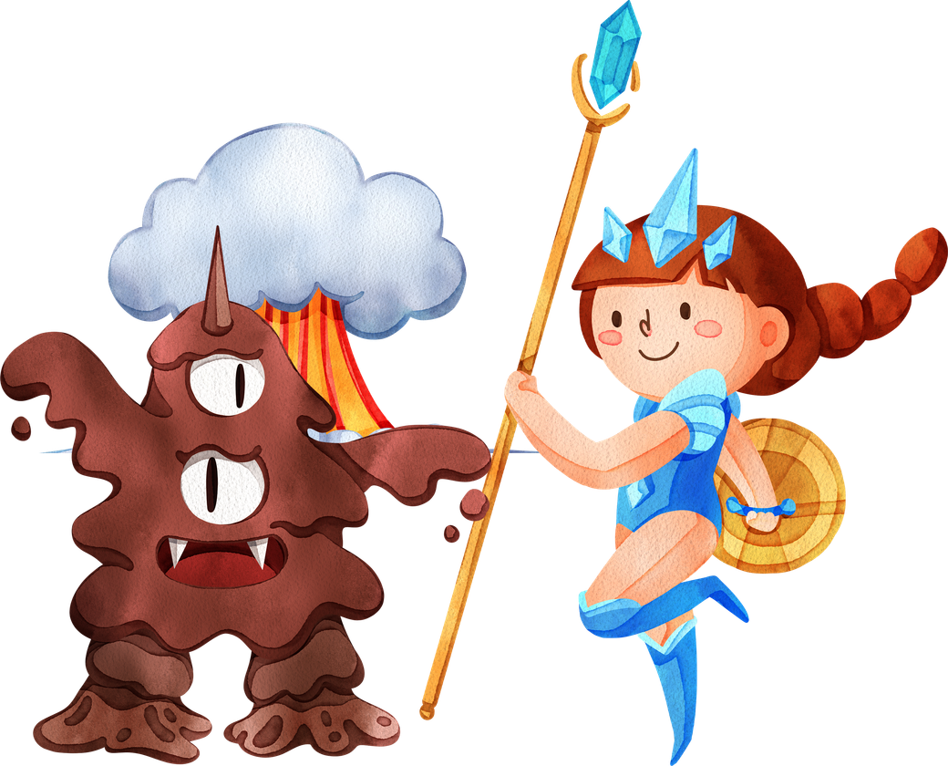


CALLED TO BE
A HERO!
FOLLOWING THE REAL HERO JESUS!

Slide 2
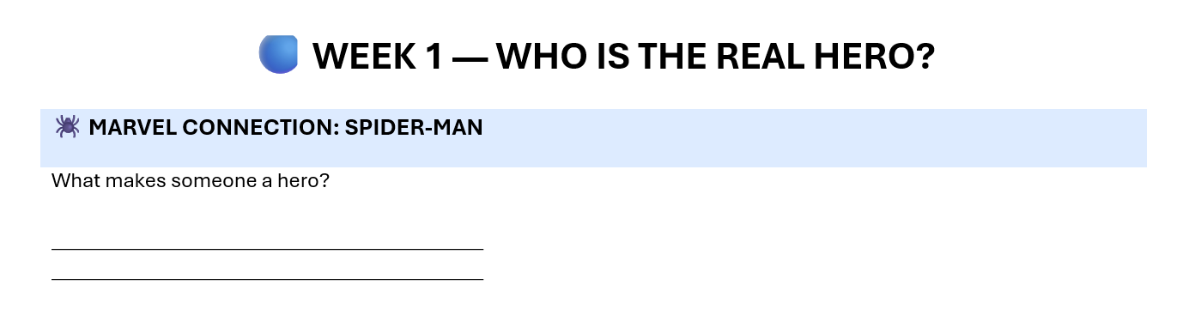
CALLED TO BE
A HERO!

Slide 3
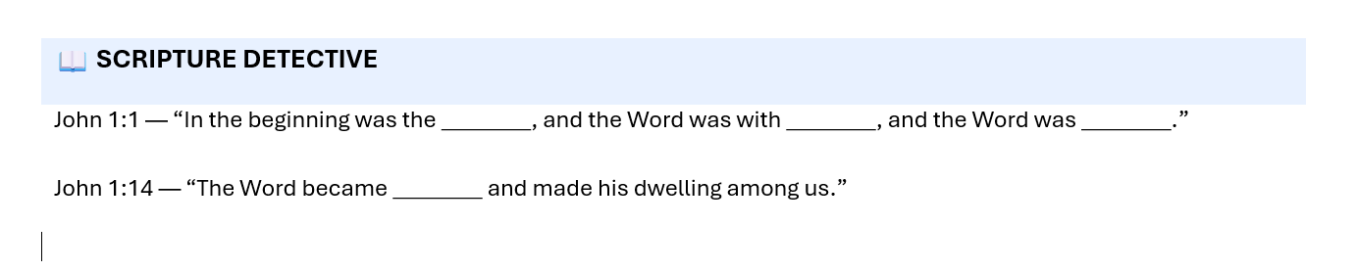
CALLED TO BE
A HERO!

Slide 4
CALLED TO BE
A HERO!
Word
God
God
Flesh

Slide 5





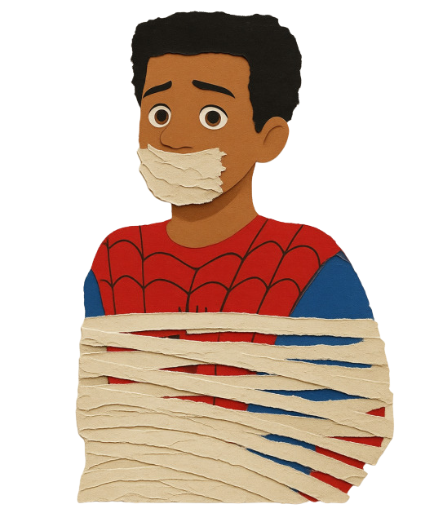



“Who is the Real Hero?”
Spider-Man Miles Morales is trapped helpless until his father encourages him to follow who he was meant to be, But Christianity begins with something even more important: knowing who Jesus really is allows us to become the Heroes we were meant to be .
https://www.youtube.com/watch?v=BmFbczWrVUw

Slide 6
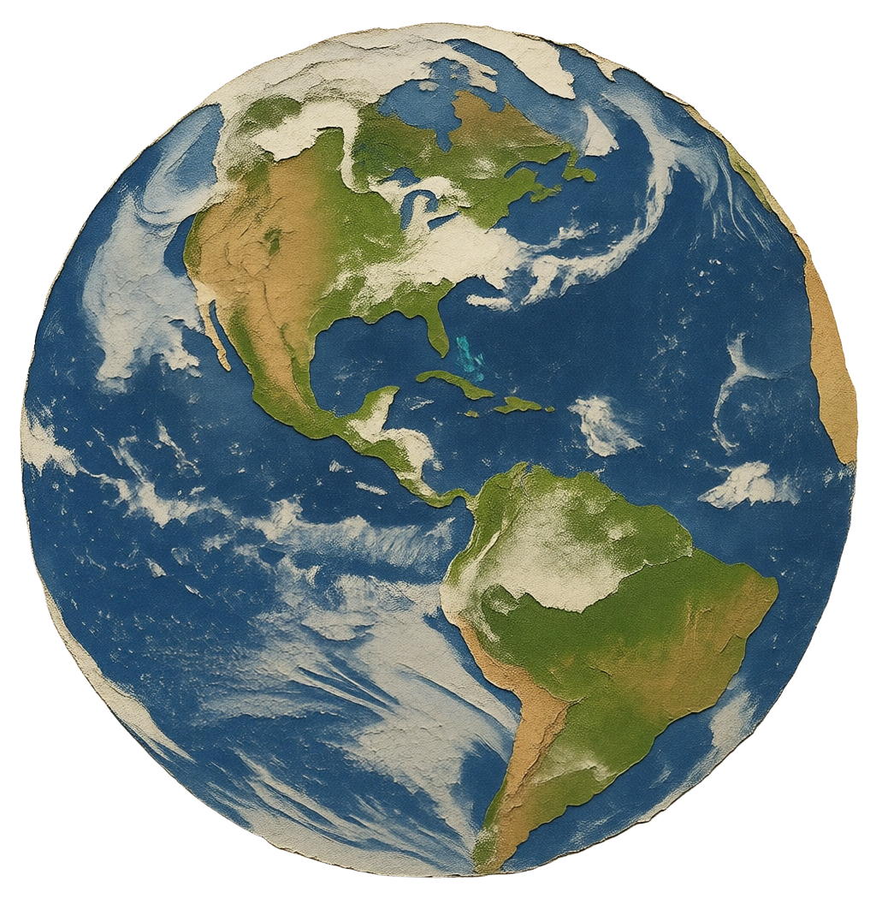
Jesus Came to earth
Jesus has more power than all the super heroes combined. Jesus has the power to create and yet humbled himself to save us!
“In the beginning was the Word, and the Word was with God, and the Word was God.” — John 1:1-3
Through Him all things were made; without Him nothing was made that has been made.”
What does this say
about Jesus?

Slide 7
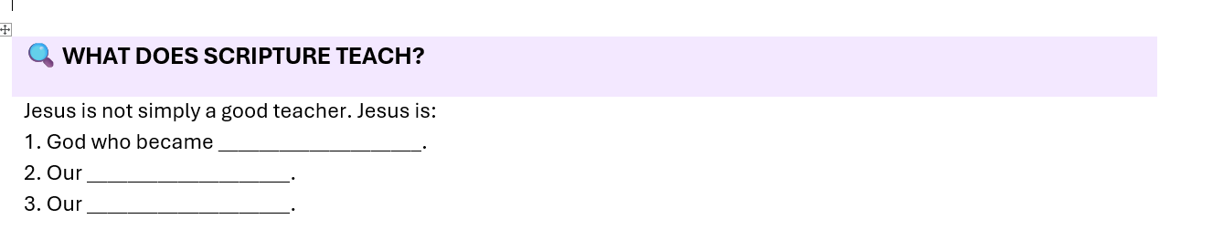
CALLED TO BE
A HERO!

Slide 8
CALLED TO BE
A HERO!
Flesh
Saviour
God

Slide 9
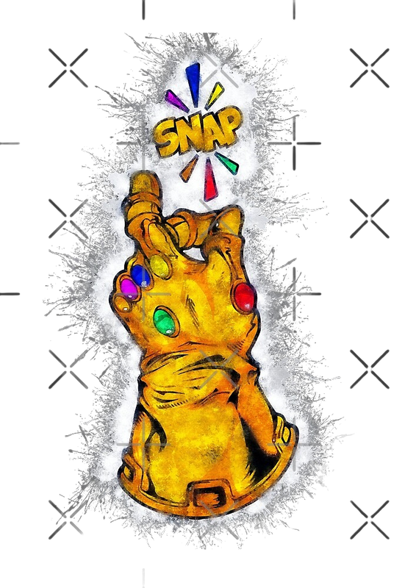
What evidence does Colossians provide about Jesus?
End-Game For Us Snap!
Romans 5:15-17
15 But the gift is not like the trespass. For if the many died by the trespass of the one man, how much more did God’s grace and the gift that came by the grace of the one man, Jesus Christ, overflow to the many! 16 Nor can the gift of God be compared with the result of one man’s sin: The judgment followed one sin and brought condemnation, but the gift followed many trespasses and brought justification. 17 For if, by the trespass of the one man, death reigned through that one man, how much more will those who receive God’s abundant provision of grace and of the gift of righteousness reign in life through the one man, Jesus Christ!
End-Game

Slide 10
Jesus The Real Snap!
What evidence does Colossians provide about Jesus?
Colossians 1;16
Who do we ultimately listen too? What was Jesus appointed too?
Hebrews 1:2
Psalm 33:6–9
What is creation and act of?
Hebrews 11:3
What do we understand about God’s creation with faith?
End-Game

Slide 11


God’s Image is In YOu!
Elohim
Creation is a unified work from the trinity or triunity.
God the Father
God the Son
God the spirit
Power
Creator
Through Genesis 1:1
Agent
Genesis 1:2
Receives
"Create man in our image" signifies that humans are uniquely fashioned to reflect God's character, endowed with reason, morality, creativity, and the capacity for relationship, and tasked with stewardship over creation (Genesis 1:26–27).

Slide 12

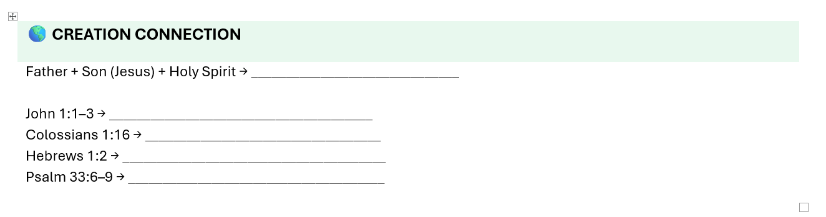
CALLED TO BE
A HERO!
Elohim is a Hebrew word that means "supreme one" or "mighty one" and is used to refer to God in the Old Testament.

Slide 13
CALLED TO BE
A HERO!
Elohim is a Hebrew word that means "supreme one" or "mighty one" and is used to refer to God in the Old Testament.
One God Elohim
Eternal Word/ Brought all existence into being
The Source and purpose of creation
Heir and agent
God spoke it “Gods Word”

Slide 14
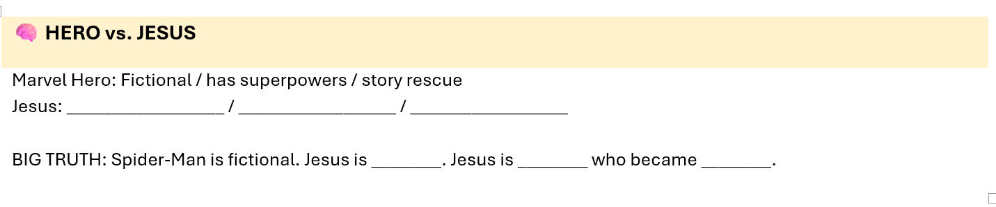
CALLED TO BE
A HERO!

Slide 15
CALLED TO BE
A HERO!
Non fiction
Supreme Power
Savior
Real
God
flesh

Slide 16
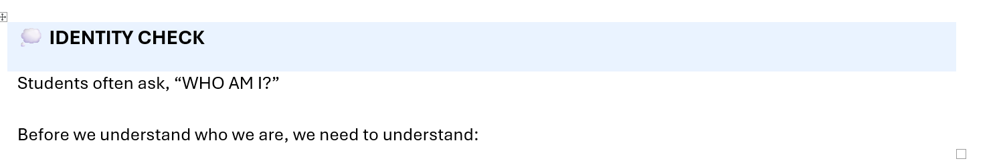
CALLED TO BE
A HERO!

Slide 17
CALLED TO BE
A HERO!
Who Is Jesus

